Slide 1
Adaptive Motor Monitoring System Based on Machine Learning Batch Training
Design Review #3
Project Team 17
Project Instructor: Prof. Ma Chengbin
Project Sponsor: CyberInsight
Company Mentor: Fang Chen, Wentao Li
Team Members: Ting Zhang, Yiwei Cheng
Chenxin Zhou, Junru Zhu
Presented by VE450 Team 17 Nov 21. 2018

Slide 2

Introduction
Conceptual design
Comprehensive analysis
Production Plan
Contents
Presented by VE450 Team 17 Nov 21. 2018

Slide 3
Part 1. Introduction

Slide 4

Review of problem
Normal
Data Behavior
Most Recent
Data
Behavior
- Traditional cloud one-time training of motor health monitoring system
Compare the recent data with the one-time model
Cloud
Cloud One-time Training:
Cloud training -> low-efficiency; Easy to lose datum
One-time training -> Non-adaptive;
An industrial motor
One-time model
Figure 1: cloud one-time training approach
* Figure 1 from https://www.vecteezy.com/

Slide 5
Needs
An python-based adaptive system monitoring machine health on the edge side, with a Web UI
Edge computing
Adaptabilty to different motors
High testing accuracy
Remote control

Slide 6


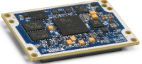
Possible solution
- Adaptive training on the edge side to monitor motor health
Viewable Web-UI interface
Edge adaptive Training:
Edge training -> guarantee efficiency
Adaptive training -> suitable in different circumstances
An industrial motor
Adaptive model on
Edge side
Figure 1: cloud one-time training approach
* Figure 1 from https://www.vecteezy.com/

Slide 7
Part 2. Conceptual Design

Slide 8
Conceptual Diagram
An industrial motor
Signal
Data Access Layer
An industrial motor
DAQ Device
Processed Signal
Controller
Real-time motor data
xy vibration + rotation speed
Business Logic Layer
Raspberry Pi with an embedded algorithm(IPCA+Q)
Incremental Principle Component Analysis(IPCA)
Trained data
Health Condition Value
Q-statistic
Health Condition Value
Presentation Layer
Web UI: flask + HTML
User
Figure 2: Morphological analysis of the project

Slide 9
Selected Design
Categories | Component | Customer Requirement
Embedded System | Raspberry Pi | Edge Computing
Algorithm | IPCA+Q ( Incremental Principal Component Analysis) SOM+MQE (Self-Organized Map) | Adapt to different motors High testing accuracy High training speed
Web User Interface | Flask + HTML | Remote Control

Slide 10
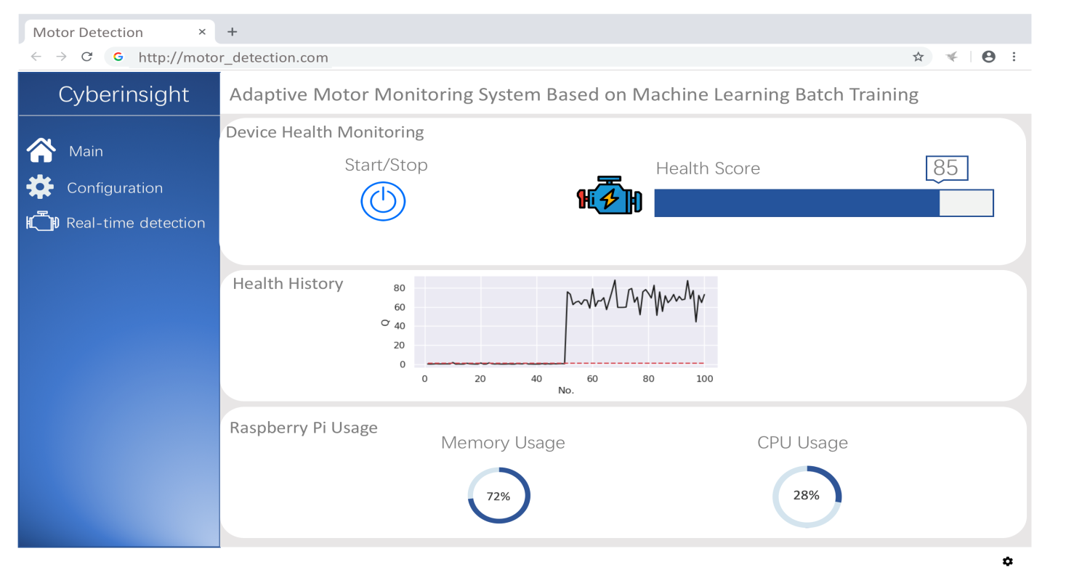
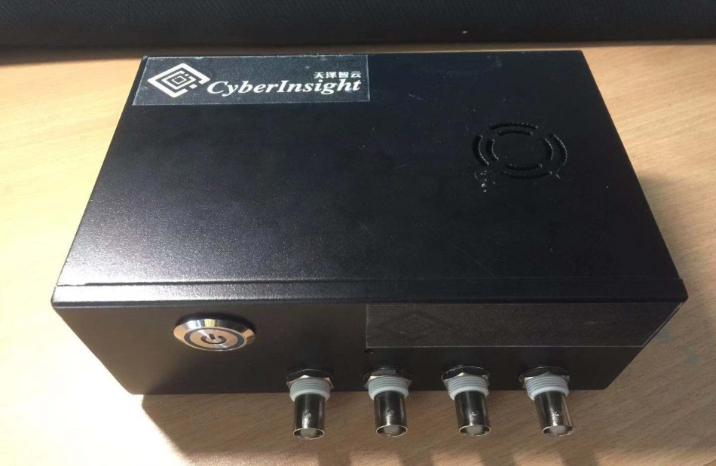
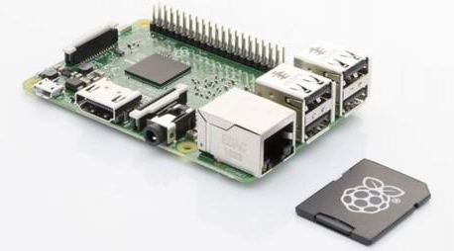
Design Description
Demo box
Buttons
Change condition
Four motors
User Interface
Customer Requirement:
User Interface
Demo Box
Raspberry Pi with Embedded Algorithm (SPCA+Q-Statistic)
Raspberry Pi
IPCA Algorithm
v

Slide 11
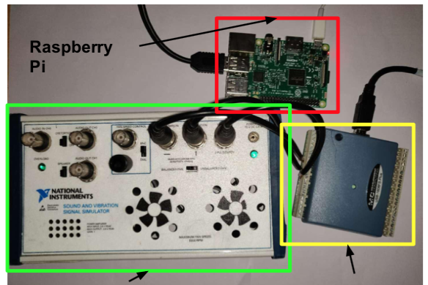
Design Description: Inside the Demo Box
DAQ: Data collection tool
Raspberry Pi: do the calculation at the edge end
Simulation Box: Simulate different conditions
Simulation Box
DAQ

Slide 12
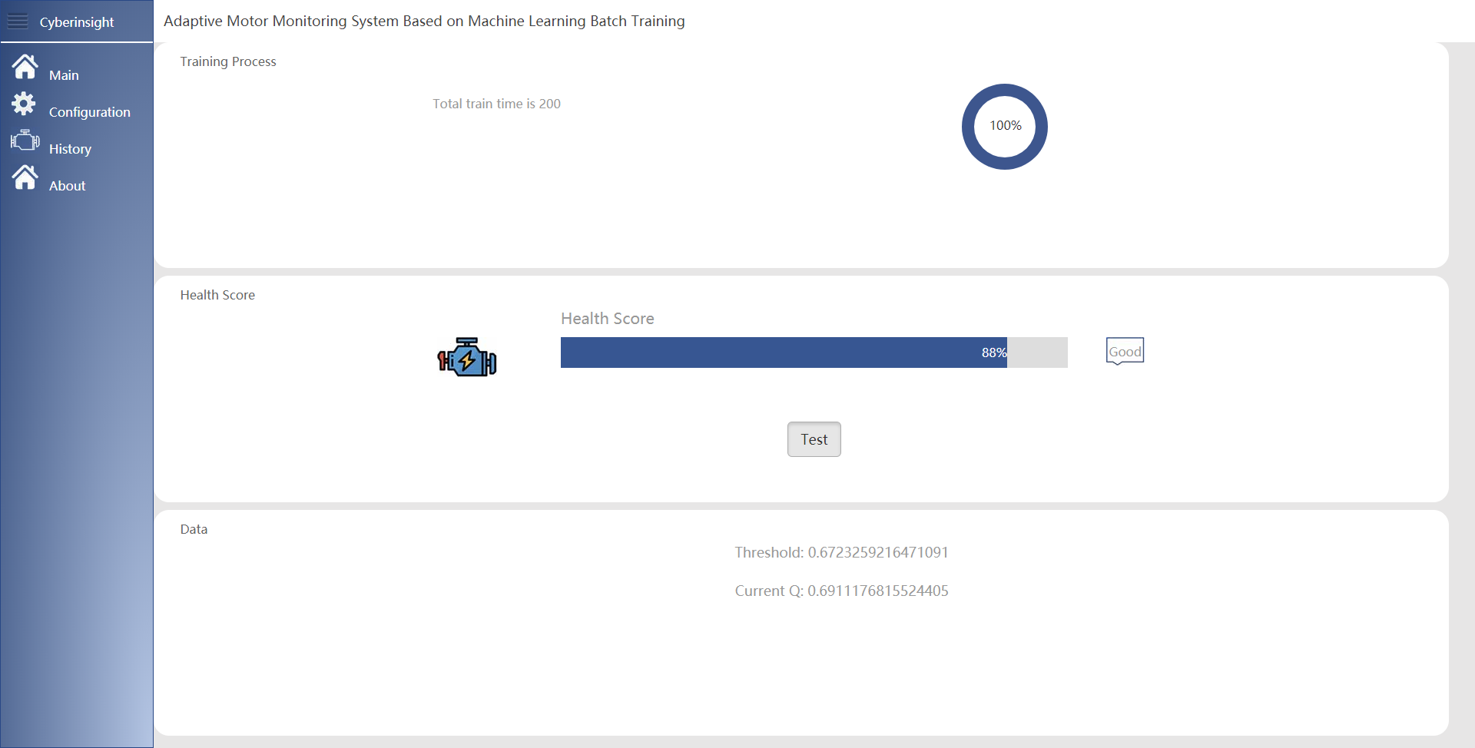
Design Description: Web UI
Training Process
Health Score
Threshold &Current Q

Slide 13
Part 3. Comprehensive Analysis

Slide 14
Validation Plan
Engineer Specification | Conduction Plan | Expected Result
Accuracy | Connect to the machine and test the false positive result | >95%
Response time | Adding the size of data and see its response according to the pressure | <200ms
Memory | Adding the size of data and see its memory condition according to pressure | <20M

Slide 15
Validation Experiment
1. Train the model to fit the current motor
2. Detect the motor's health condition
3. Change the motor type by altering its rotating speed
4. Detect the motor's health condition
5. Check whether the old model still fits
6. Re-train model to fit new type motor
7. Detect the motor's health condition
Detect
Train
Change Simulation Motor DataType
Re - train
Detect

Slide 16
Experiment Test Objects
Testing Accuracy
Detect
Train
Change Simulation Motor DataType
Training time
Re - train
Detect
Response Time

Slide 17
Quantitative Results
Training batch size as 100 datums/batch works well in experiment
Memory storage: 1M
Including both datums and images in UI
For each detection period, we test 100 times using the healthy score
Only two samples report the wrong motor status => Accuracy 98%
One second is used to reach the 100% progress in training progress bar for 2000 datums.
Training speed is 2000 datum/s
Web User Interface response time is about 200 ms tested by the web itself

Slide 18
Analysis of Experiment Result
Categories | Component | Experiment Results | Engineering Specification
Embedded System | Raspberry Pi | Memory: 1M | Memory Required < 20M
Algorithm | IPCA+Q SOM+MQE | Testing Accuracy: 98% Training Speed: 2000 datum/s | Testing Accuracy > 95% Training Speed > 500 datum/s
Web User Interface | Flask + HTML | Response Time: 200 ms | Response Time < 200 ms

Slide 19
Part 4. Production Plan

Slide 20
Manufacturing Plan
Material | Quantity | Budget | Version
DAQ | 1 | 650RMB | NI USB-6008 DAQ 779051-01
Raspberry PI | 1 | 663RMB | Raspberry Pi3 B+
Server | 1 | 825RMB/year | Ali Cloud 2 core CPU, 4G cache

Slide 21

Video

Slide 22
Project Schedule
Sep 25
Oct
04
Oct 11
Oct
20
Oct
29
Nov
8
Nov
17
Nov
26
Dec 05
A
100%
B
100%
C
100%
D
100%
E
65%
F
Completed
Incomplete
Checkpoint Time
A
Literature Research
D
Embed the algorithm into the system
B
Implementation of the algorithms
F
Design of Web UI for a final demo
C
Comparison and test
Final test
E

Slide 23
Reference
[1] Borah, Samarjeet, Ranjit Panigrahi, and Anindita Chakraborty. "An Enhanced Intrusion Detection System Based on Clustering." Progress in Advanced Computing and Intelligent Engineering. Springer, Singapore, 2018. 37-45.
[2] Yao, Zhewei, et al. "Hessian-based Analysis of Large Batch Training and Robustness to Adversaries." arXiv preprint arXiv:1802.08241 (2018).
[3] Robinson, Melvin D., et al. "Properties of a Batch Training Algorithm for Feedforward Networks." Neural Processing Letters 45.3 (2017): 841-854.
[4] Buczak, Anna L., and Erhan Guven. "A survey of data mining and machine learning methods for cyber security intrusion detection." IEEE Communications Surveys & Tutorials 18.2 (2016): 1153-1176.
[5] Kohonen, Teuvo. "The self-organizing map." Proceedings of the IEEE 78.9 (1990): 1464-1480.
[6] Reynolds, Douglas. "Gaussian mixture models." Encyclopedia of biometrics (2015): 827-832.
[7] Holland, Steven M. "Principal components analysis (PCA)." Department of Geology, University of Georgia, Athens, GA(2008): 30602-2501.

Slide 24
Thank you!

Slide 25
Q & A

